Slide 1
Pavan Kumar Aryasomayajulu
I work as a Software Architect at Sails Software Solutions

Slide 2
What is Elastic Search?
Elastic Search is a search engine based on Lucene
Near real time search
Some real time issues I faced with Near real time.
Distributed Elasticsearch is a distributed, open source search and analytics engine for all types of data, including textual, numerical, geospatial, structured, and unstructured. Elasticsearch is built on Apache Lucene

Slide 3
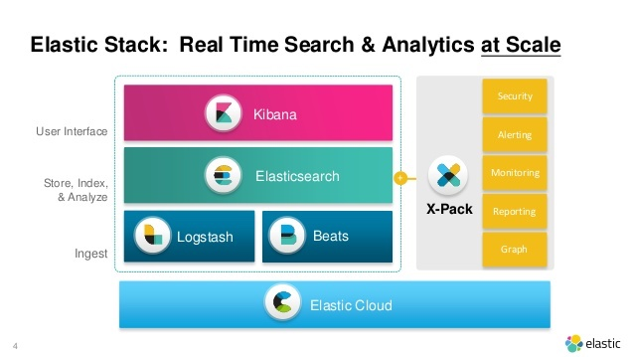
Elk Stack

Slide 4
Installing ElasticSearch Using Docker

Slide 5
Key Terminologies
Document: It is the basic component of ES. It contains data.
Index: Collection of documents
Shard is a Lucene Index which contains documents
Node: A single server which contains multiple shards
Cluster: A collections of Nodes

Slide 6
Replica Shards
Replica Shard is a copy of Primary Shard. The main reason for having a replica shard is to make sure that even if the primary shard /node is down, but still we want our application to run.

Slide 7
We are expecting to store documents related to a Q&A site. I am expecting that the overall load of my site will never exceed 50GB. My machine size is around 1TB and I gave a good amount of RAM. I am not worried even If my site is down for a certain time(even hrs) and I can restore data from somewhere or ok to loose data during downtime or ok even if the data is completely lost because of a hardware failure.

Slide 8
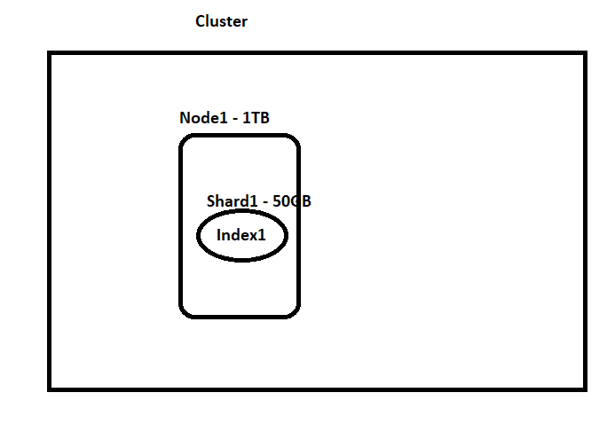

Slide 9
We are expecting to store documents related to a Q&A site. I am expecting that the overall load of my site will never exceed 50GB. My machine size is around 1TB and I gave a good amount of RAM. I am not worried even If my site is down for a certain time(even hrs) and I can restore data from the snapshot and It is ok to lose data during downtime but not complete data

Slide 10
PUT testshard { } Get _cat/indices Lets observe status of index

Slide 11
Now lets try to make index status green?

Slide 12
PUT testshard { "settings": { "number_of_replicas": 0, "number_of_shards": 1 } }

Slide 13
We are expecting to store documents related to a Q&A site. I am expecting that the overall load of my site will never exceed 50GB. My machine size is around 1TB and I gave a good amount of RAM. I want to make sure that we will not have any downtime but I am ok to take the minimal chance of downtime

Slide 14
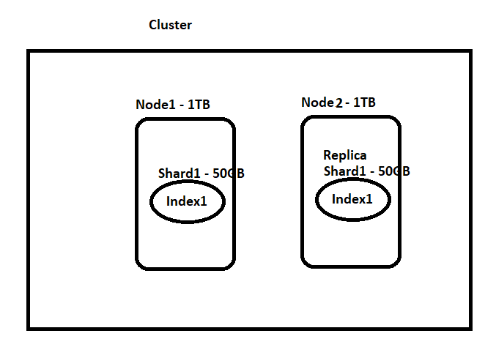

Slide 15
Show demo in Docker Playground

Slide 16
I am expecting that the overall load of my site might be around 1.5TB. My machine size is around 1TB and I gave a good amount of RAM. I want to make sure that we will not have any downtime but I am ok to take the minimal chance of downtime. — Now read below section and decide :)

Slide 17
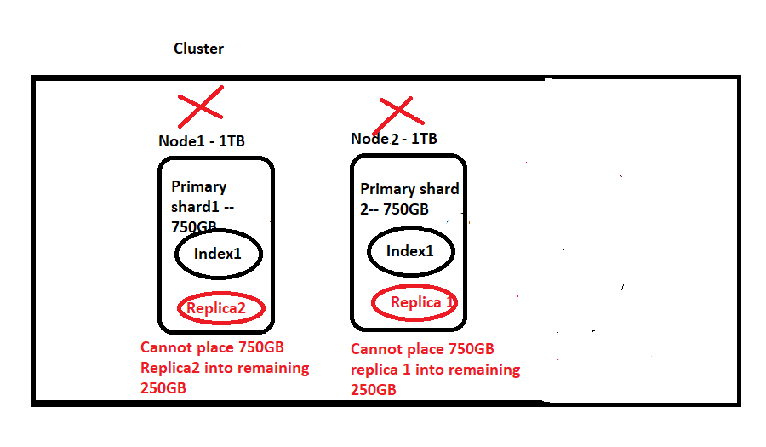

Slide 18
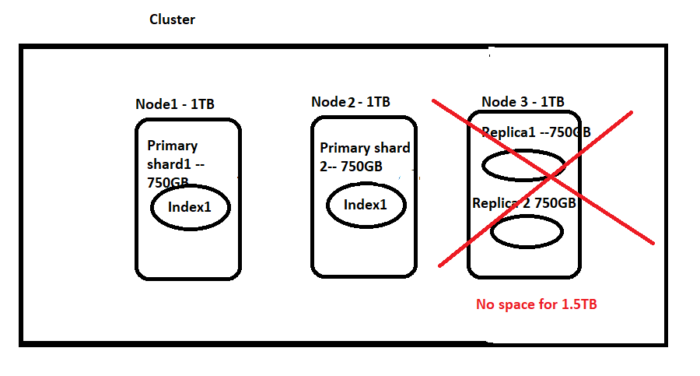

Slide 19
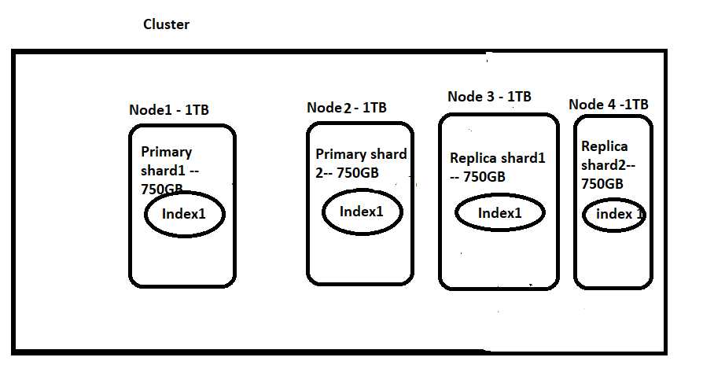

Slide 20
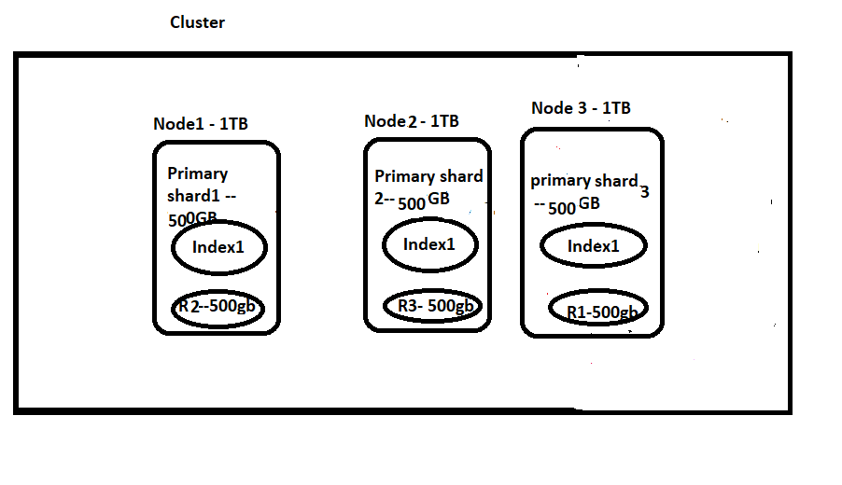

Slide 21
Index some data using Python file

Slide 22
Index Some Data Using Logstash

Slide 23
Inverted Index
Inverted Index is the primary data structure of elastic search. This data structure is the core of the search engine and makes lookup possible

Slide 24
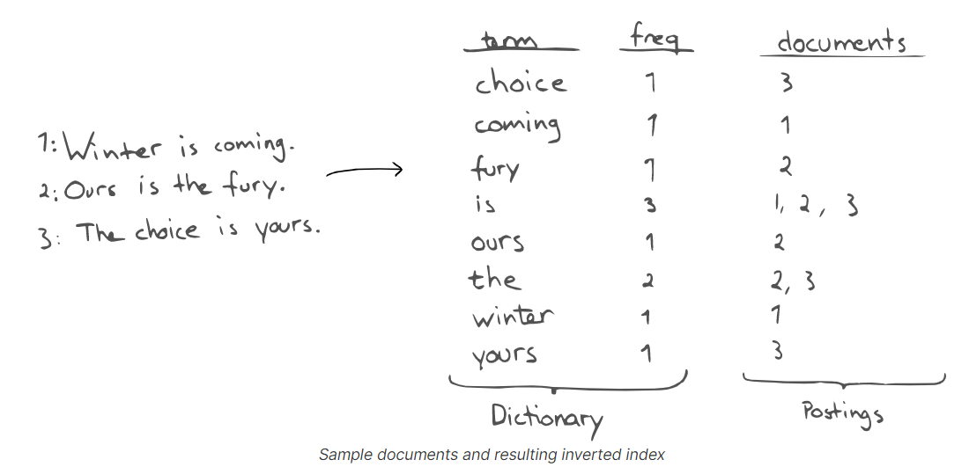

Slide 25
Lets Get Into Action
I think we are done with bulk data upload and Setup.
Now Lets try playing with ElasticSearch
AS I am from RDBMS background, I’ll try to compare Elastic search with RBDMS when ever it is possible.

Slide 26
Create Index in ES
Elastic Search (Index) | SQL Server(Table)
Sharding – It can be used to distribute data across multiple nodes in a cluster Replication can be configured at index level So we need to specify shard details and replication details at the time of index creation or else it will take default values 1 and 1 for shards and replications Schema specification is not required and It will automatically infers schema from 1st inserted record.(They can be prevented by certain settings) | 1.Fully partitioning data across multiple servers isn’t something that SQL Server does out of the box 2. Replication is done at DB level 3.It is not required to specify shard or Replication details when creating tables 4. Schema needs to be defined at the time of table creation

Slide 27
Mapping
Put stackoverflow_top/
{
"mappings":
{
"properties":
{
"field1":{
"type":"text",
"fields":{
"keyword":
{
"type":"keyword"
}
}
},
"field2":{
"type":"integer"
},
"field3":
{
"type":"float",
"index":false
}
}
}
}

Slide 28
Datatypes
String text and keyword
Numeric long, integer, short, byte, double, float, half_float, scaled_float
Date
date
Boolean boolean
Binary binary
Range integer_range, float_range, long_range, double_range, date_range, ip_range
Object object for single JSON objects
Nested
nested for arrays of JSON objects

Slide 29
Update Mappings
Put stackoverflow_top/_mappings
{
"properties":
{
"parentfield4":
{
"type":"nested",
"properties":
{
"nestedfield4_1":
{
"type":"text"
}
}
}
}
}

Slide 30
Adding Array Mapping
Put stackoverflow_top/_mappings
{
"properties": {
"parentfield5_array": {
"properties": {
"nestedfield5_1": {
"type": "text"
}
}
}
}
}

Slide 31
Why Nested Docs?
PUT my-index-000001/_doc/1 { "group" : "fans", "user" : [ { "first" : "John", "last" : "Smith" }, { "first" : "Alice", "last" : "White" } ] }

Slide 32
Fields in Mapping
Put stackoverflow_top
{
"mappings":
{
"properties":
{
"field1":
{
"type":"text",
"fields":
{
"raw":
{
"type":"keyword"
},
"whitespace":
{
"type":"text",
"analyzer":"whitespace"
}
}
}
}
}
}

Slide 33
Restricting at Mapping level. This way we are making sure that we dont get unwanted fields
PUT stackoverflow_top/
{
"mappings": {
"dynamic": "strict",
"properties": {
"test": {
"properties": {
"foo": { "type": "text" },
"bar": {
"type": "nested",
"properties": {
"bell": { "type": "text" }
}
}
}
}
}
}
}

Slide 34
To make it dynamic again
PUT /stackoverflow_top/_mapping
{
"dynamic": “true"
}

Slide 35
Dynamic =false
PUT /stackoverflow_top/_mapping
{
"dynamic": “false"
} Usually these fields are not indexed and cannot be queried. Show demo on Luke

Slide 36
Demo Luke
Post <index>/_refresh

